Slide 1



Slide 2

BUSINESS ANALYTICS Introduction to Business Analytics and Core Business Functions
BUSINESS ANALYSIS Reporting and Storytelling

Slide 3
Learning Objectives – WEEK 12
By the end of today you should be able to:
Understand what makes a strong business report
Tell a compelling story using data
Communicate insights to different stakeholders
Build executive summaries that drive decisions
Avoid common reporting mistakes
Data doesn’t convince people — stories do.
Notes:
“Throughout this course, we’ve learned how to gather requirements, analyze processes, and define KPIs. Today we learn how to communicate insights in a way that drives decisions.”
Then say:
“Data doesn’t convince people — stories do.”
Explain:
“Today is about how Business Analysts turn data into action.”

Slide 4
Previous Week - 10
Last week we learned:
✔ Charts ✔ Dashboards ✔ Visual principles
Now we go further:
👉 How do you present insights so people actually act?
Notes:
“Last week we learned visualization — charts and dashboards.”
Ask:
“But what if stakeholders still don’t act after seeing charts?”
Explain:
“Because charts alone don’t drive decisions — stories do.”

Slide 5
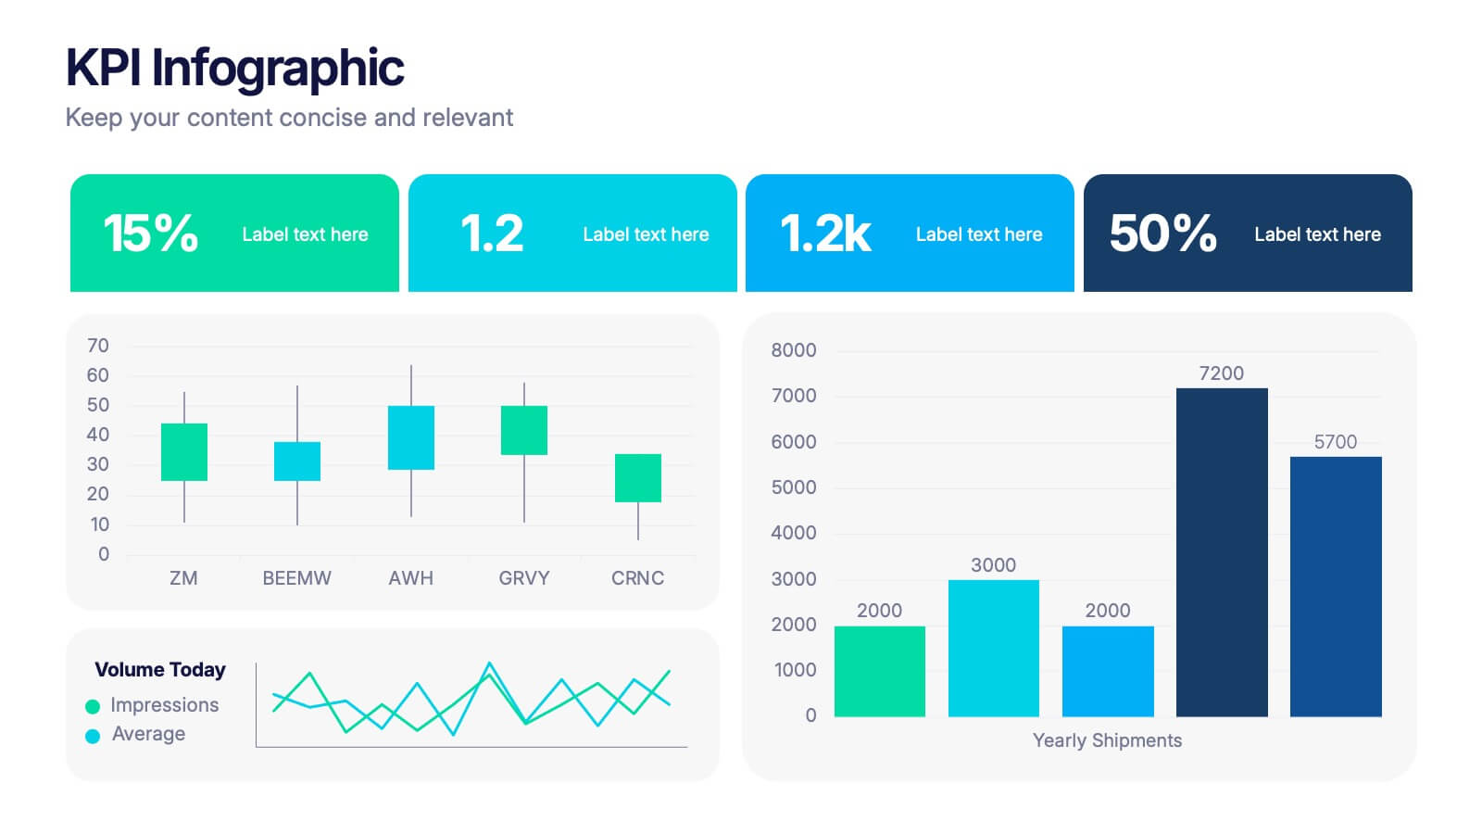
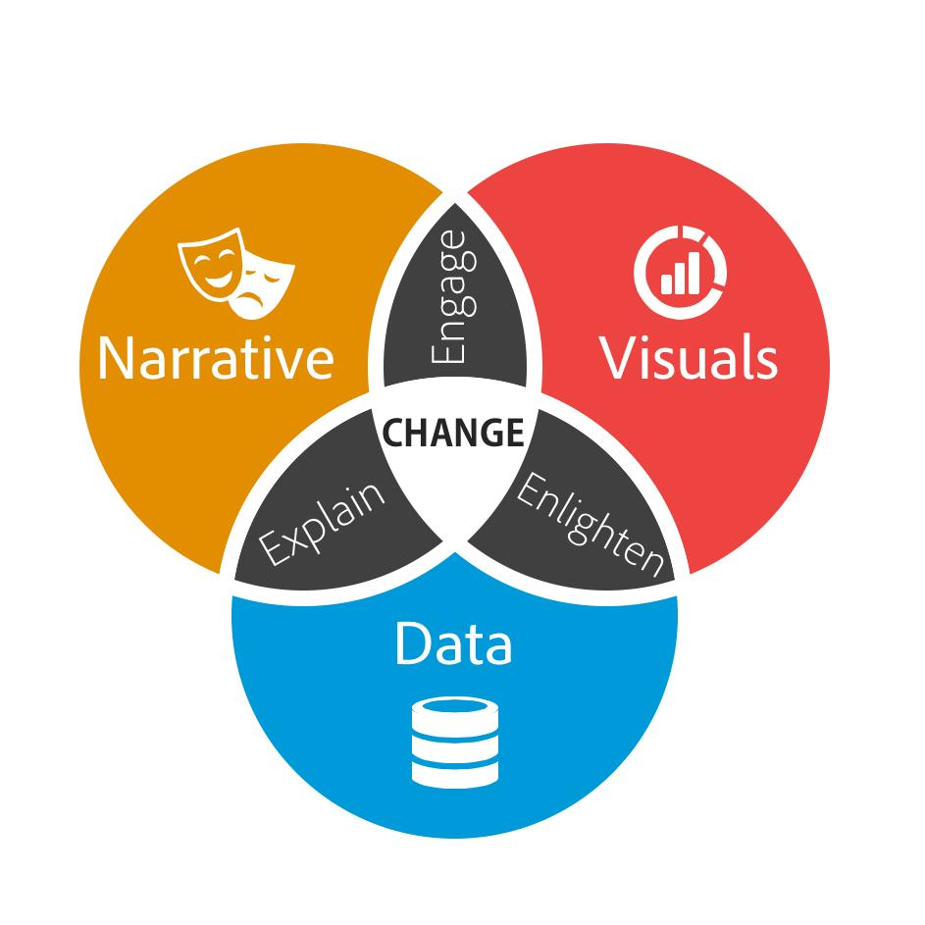
WHAT IS DATA STORYTELLING?
Data Storytelling = Data + Context + Narrative
A good report answers:
✔ What happened? ✔ Why did it happen? ✔ What should we do?
🇵🇰 Pakistan Example
A delivery app dashboard shows:
Orders ↑
Delivery time ↑
Customer complaints ↑
Data Story:
Growth is causing operational strain. Automation required.
🌎 International Example
Netflix:
Data shows user drop after episode 2.
Story:
Content engagement issue, not platform issue.
Notes:
Data Storytelling = Data + Context + Narrative
Explain:
“Numbers tell you what. Stories tell you why and what to do next.”

Slide 6
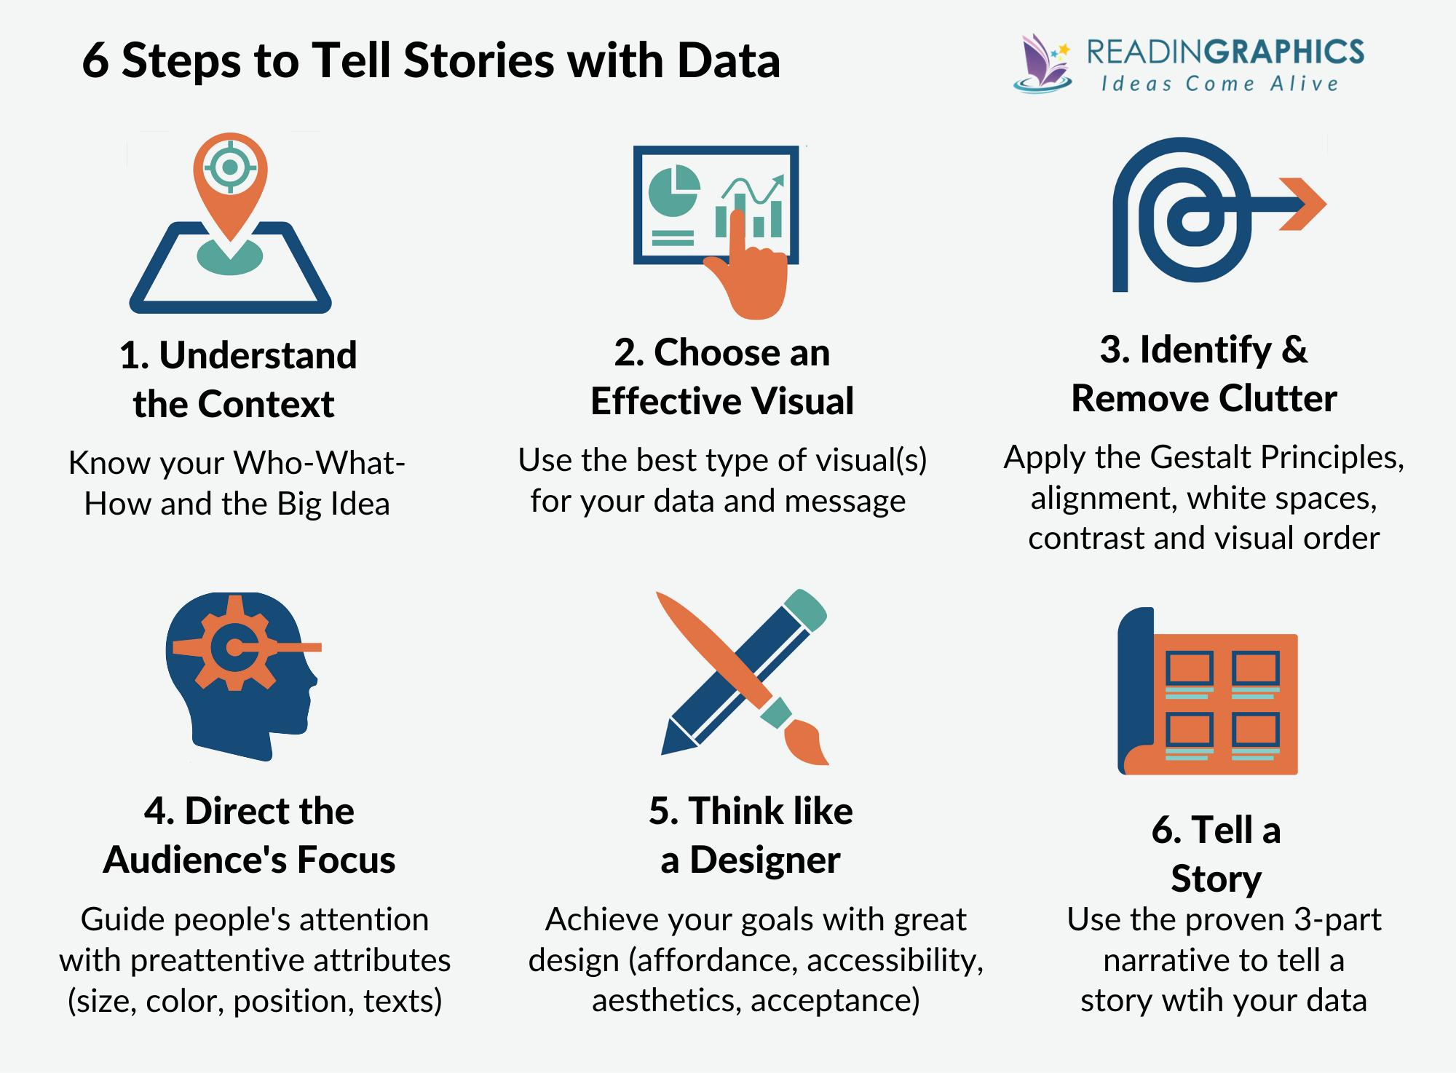
What is Data Storytelling?
Notes:
Data Storytelling = Data + Context + Narrative
Explain:
“Numbers tell you what. Stories tell you why and what to do next.”

Slide 7

STRUCTURE OF A STRONG BUSINESS REPORT
1️⃣ Context
What’s the situation?
2️⃣ Insight
What did the data show?
3️⃣ Impact
Why does it matter?
4️⃣ Recommendation
What should be done?
Example
Context: Delivery delays increasing.
Insight: Peak-hour delays spike by 40%.
Impact: Customer churn risk.
Recommendation: Automate rider assignment.
Notes:
Example
Context:
Delivery delays increasing.
Insight:
Peak hour delays increased 40%.
Impact:
Customer churn risk.
Recommendation:
Automate rider assignment.
Say:
“This structure keeps your message clear and convincing.”

Slide 8
Executive Summary
Executives don’t read long reports.
They want:
✔ Key numbers ✔ Risks ✔ Decisions needed
Template
Problem
Key Data
Impact
Recommended Action
🇵🇰 Example
QuickBasket Executive Summary:
Delivery delays increased 30% due to manual assignment. Recommend automated dispatch system to improve delivery time and customer satisfaction.
“A strong executive summary saves hours of meetings.”
Notes:
“Executives don’t read long reports. They need quick decisions.”
Executive Summary Template
Problem
Key Data
Impact
Recommendation

Slide 9
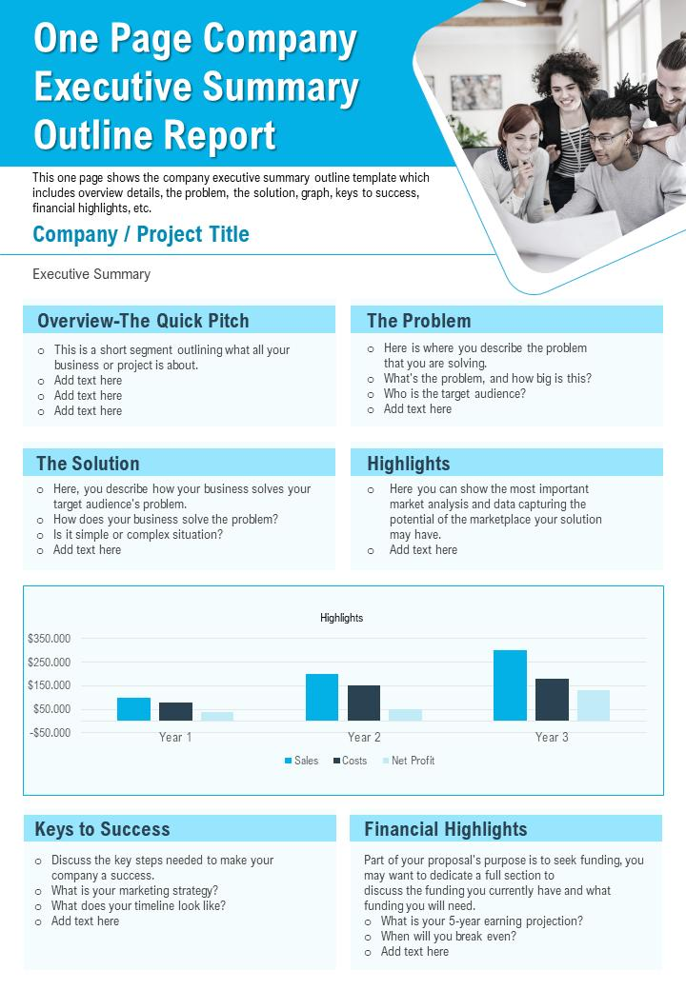
Executive Summary
Notes:
“Executives don’t read long reports. They need quick decisions.”
Executive Summary Template
Problem
Key Data
Impact
Recommendation

Slide 10
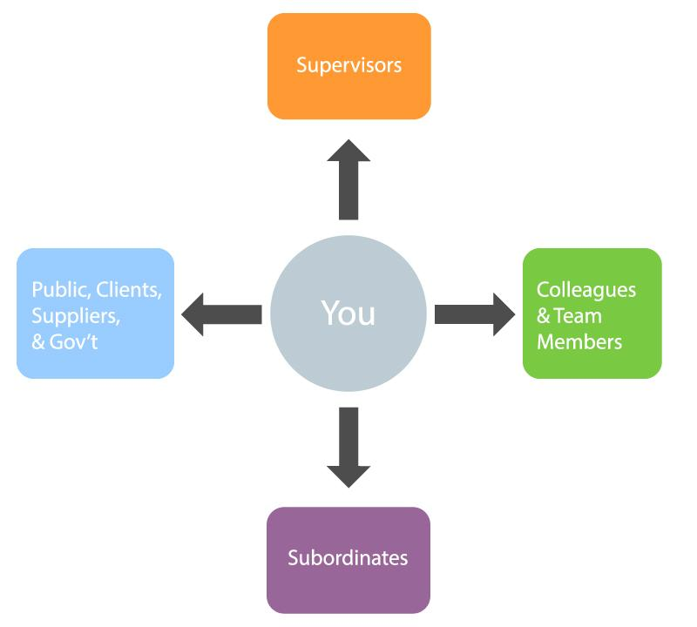
Audience Matters
Same data → different communication style.
Audience | Focus
CEO | Business impact
Developer | Technical details
Operations | Workflow
Client | Value delivered
Example
Delivery Delay Report:
CEO: Revenue impact.
Operations: Staff workload.
Developers: System performance.
Notes:
“The same data must be presented differently to different stakeholders.”
Audience Focus
CEO → Business impact
Developer → Technical detail
Operations → Workflow
Client → Value delivered

Slide 11
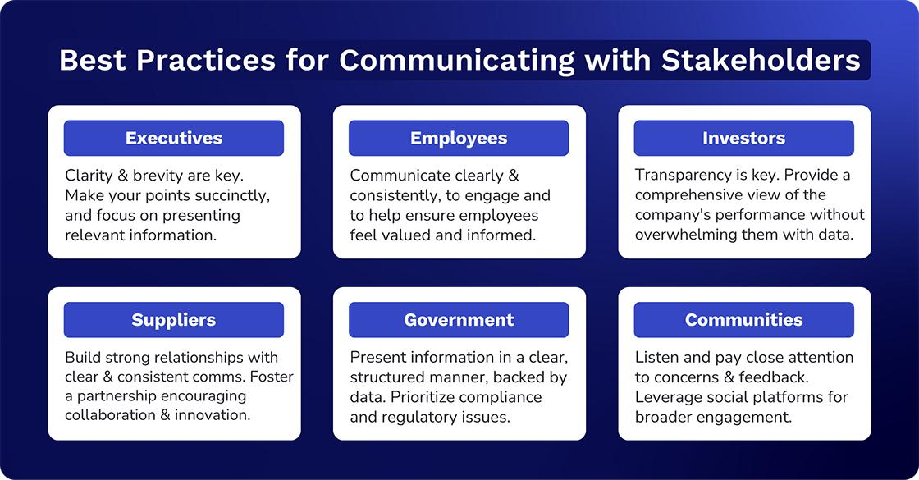
Audience Matters

Slide 12
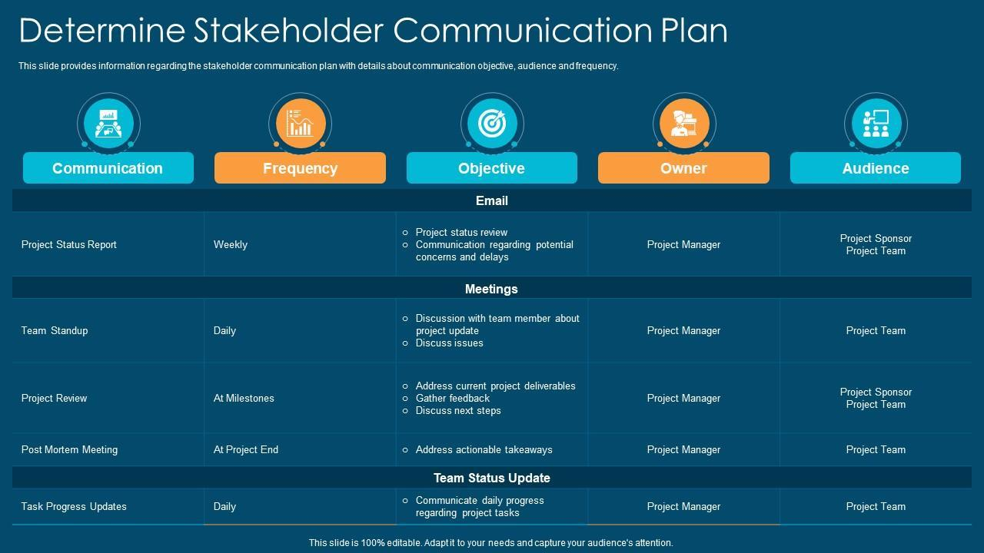
Audience Matters

Slide 13
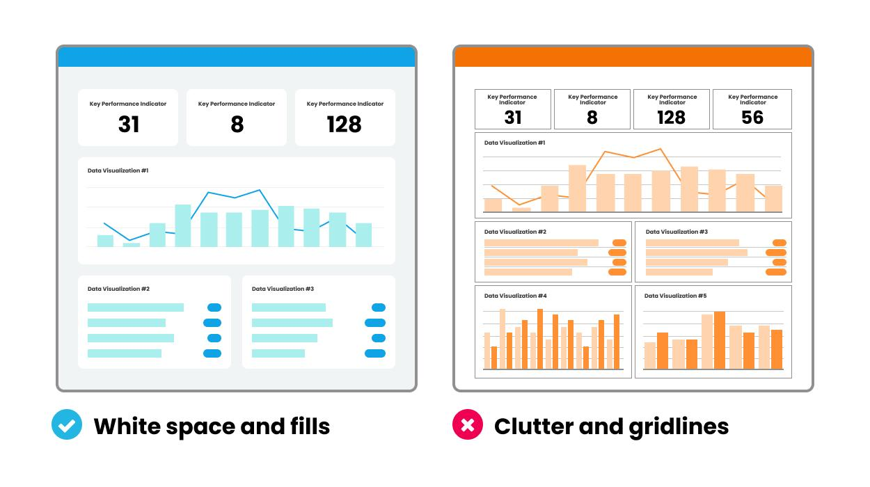
Common Reporting Mistakes
❌ Too much data ❌ No clear message ❌ No recommendation ❌ Confusing visuals ❌ No context
Tip
Don’t say:
“Delivery time is high.”
Say:
“Delivery time increased 20% due to manual dispatch.”

Slide 14
Activity
Create a Mini Report
Give students scenario:
QuickBasket delivery delays increased.
Ask students to:
1️⃣ Identify key issue 2️⃣ Write one insight 3️⃣ Write one recommendation
Notes:
Expected Example
Issue:
Delivery delays.
Insight:
Manual assignment causes 70% of delays.
Recommendation:
Automate rider assignment.
Walk around and give feedback.

Slide 15
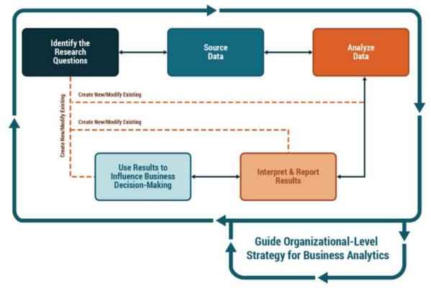
Converting Insights into Action
Insights must lead to decisions.
Example:
Insight: Orders increasing.
Wrong Conclusion: “Business is good.”
Better Conclusion: “Growth is stressing operations → need scaling.”
Good BAs recommend actions, not just report numbers.”
Notes:
“Insights without decisions are useless.”
Example
Insight:
Orders increasing.
Wrong conclusion:
“Business is good.”
Better conclusion:
“Growth is stressing operations — need to scale.”
Say:
“Good BAs recommend actions, not just report numbers.”

Slide 16
Link to Business Decisions
Explain:
Good reporting leads to:
✔ Investment decisions ✔ Hiring decisions ✔ Feature prioritization ✔ Process improvement
Example
Data shows high demand in Lahore.
Decision:
Expand fleet there.
Data → Analysis → Insight → Recommendation → Decision

Slide 17
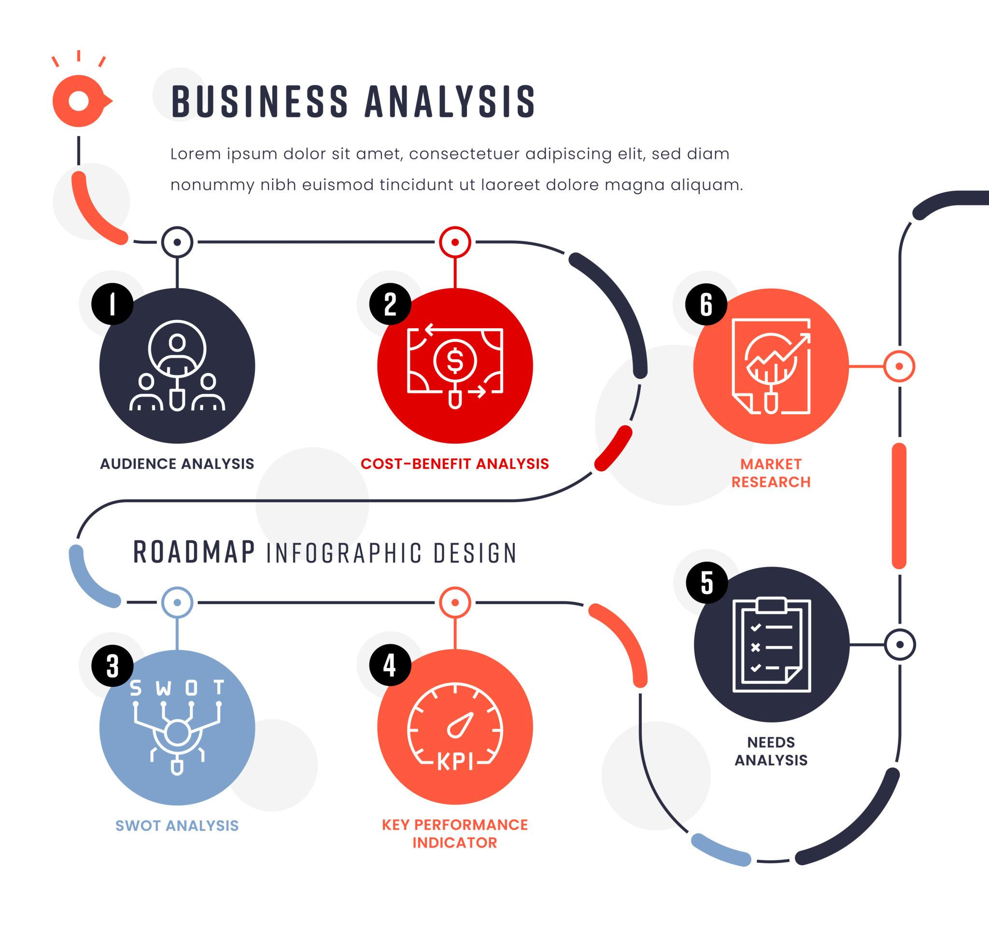
BA Role in Reporting
Business Analyst must:
✔ Analyze data ✔ Communicate clearly ✔ Recommend actions ✔ Influence decisions
Real World Insight
BA success is judged by:
👉 Clarity of insights 👉 Quality of recommendations

Slide 18
KEY TAKEAWAYS (END OF LECTURE)
✔ Data storytelling influences decisions ✔ Reports must be clear & concise ✔ Audience matters ✔ Insights must drive action ✔ Good BAs communicate, not just analyze
“Many dashboards fail because they show data, not decisions.”
“Executives don’t need data — they need direction.”
“A strong BA turns numbers into narratives.”
Notes:
“Visualization turns data into understanding.”
Repeat:
Visualization simplifies complexity
Right chart = correct insight
Dashboards support decisions
BA interprets and communicates

